Slide 1
Challenges for this Workshop
Thomas Buchert
TORUŃ 2017
CRALLYON

Slide 2
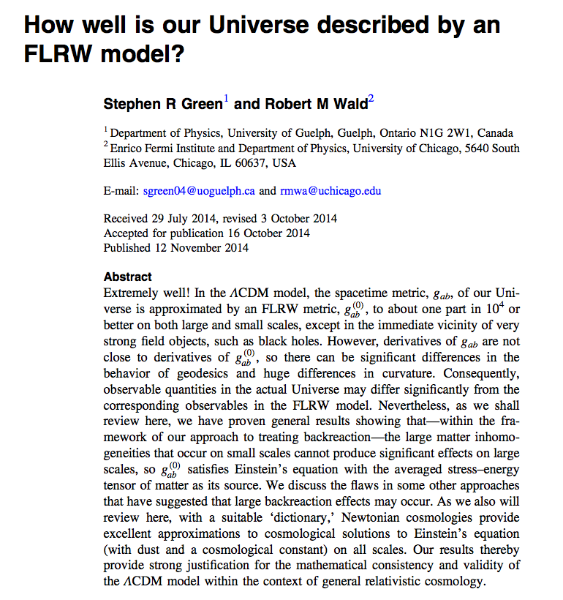
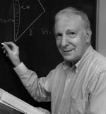
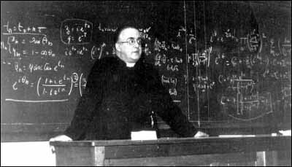
Curvature evolution is key
The Standard Model works
``extremely well‘‘
1927 - 2015
No longer a Challenge
Metric Perturbations are small
except in the vicinity of neutron stars
Backreaction is trace-free
Ishibashi and Wald 2006
Green and Wald 2013

Slide 3
Rebuttals help
Challenge 1
Backreaction is not trace-free
Curvature is key

Slide 4
arXiv:0906.0134
Based on notes by Jürgen Ehlers (2007)
Curvature is not a ``relativistic effect‘‘

Slide 5
t
Challenge 2
Curvature is non-perturbative
Curvature evolution is key

Slide 6
Present-day Universe
Q_{D} ≈ 0 <ρ> ≈ 0 :
<R> - 2 Λ ≈ – 6 H²
Averaged Hamiltonian Constraint
Challenge 3
Qualitative models give
negative average curvature
for a void-dominated present-day Universe

Slide 7
Challenge 4
Non-Conservation of Curvature
Subtle thing !

Slide 8
t
Curvature is not conserved
while Restmass is conserved

Slide 9
Most recent development
Backreaction in Newtonian Cosmology
Newtonian Simulations
?
Non-Conservation of Curvature
Background Evolution
Dark Energy

Slide 11
arXiv:1704.00703

Slide 12
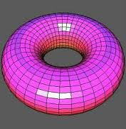
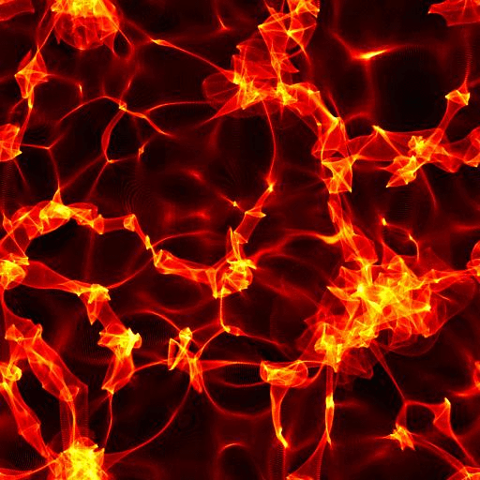
Newtonian ``Anchor‘‘
Theorem: Q = 0 on 3-torus
Buchert and Ehlers 1997
Flat Space – Periodicity –
Fourier transformation – Background-dependence ...

Slide 13
DRAFT only
Challenge 5
One-percenters vs. Order unity advocats

Slide 14
Quasi-Newtonian Metric Form
Metric is conformally flat (Cotton-York-Tensor vanishes)
Extrinsic Curvature is trace-free

Slide 15
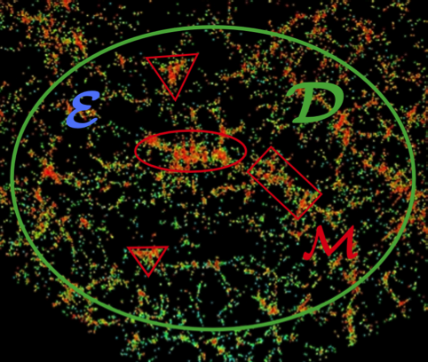
u
n
Collins-Wainwright-Theorem
Trümper (1968):
zero shear homogeneous
Ishibashi and Wald (2006)
Challenge 6
Almost-Collins-Wainwright-Theorem ?
Is backreaction is found to be a one-percent effect,
just because the metric is ``almost homogeneous‘‘ ?

Slide 16
Challenges for this Workshop
Curvature is key
Second derivatives of the metric are of order 1
average curvature matters
Curvature evolution is key
Negative average curvature
for a void-dominated Universe
Curvature is not conserved
Background evolution / Fixed Background
Curvature is non-perturbative
Non-applicability of
quasi-Newtonian metric forms
Re-Interpretation of Observations !

Slide 17
... if you want to find good bars

